Slide 1
FUNDAMENTAL CONCEPTS
UNIT 2

Slide 2
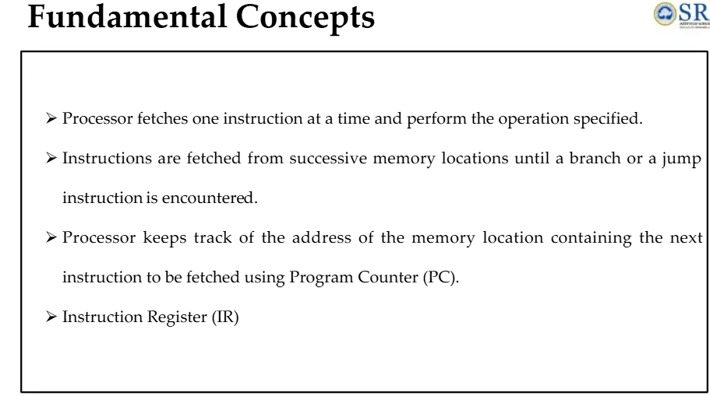

Slide 3
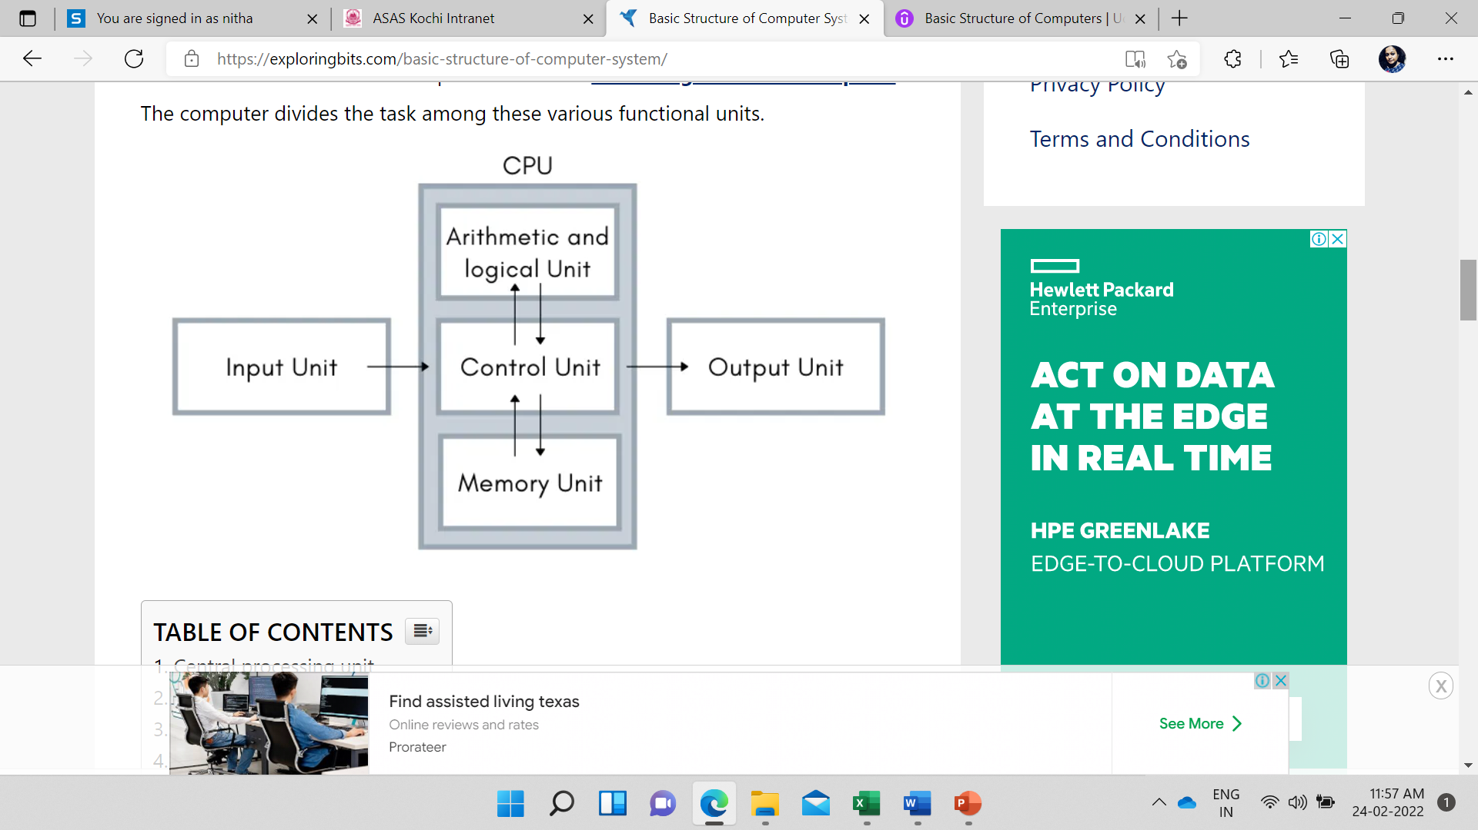
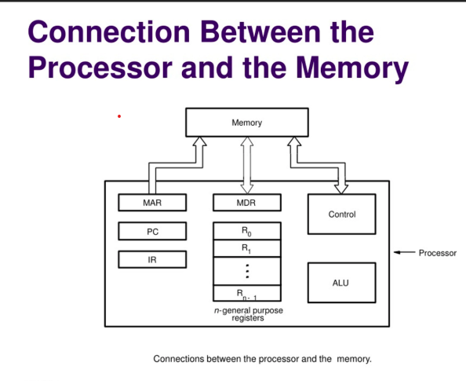

Slide 4
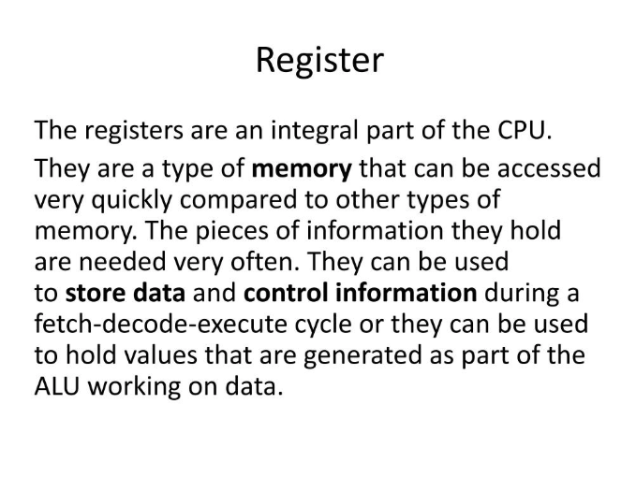
SOME OF THE REGISTERS
Program Counter (PC)
Instruction Register (IR)
Memory Address Register (MAR)
Memory Data Register (MDR)
General Purpose Registers

Slide 5
General Purpose Registers
A register is a collection of flip-flops. Single bit digital data is stored using flip-flops. By combining many flip-flops, the storage capacity can be extended to accommodate a huge number of bits. We must utilize an n-bit register with n flip flops if we wish to store an n-bit word.
General Purpose Registers (GPRs) are essential components within a CPU, serving as temporary storage locations for data that is actively being processed. Unlike special-purpose registers, which are dedicated to specific tasks, GPRs are versatile and can store a wide variety of data, including operands for arithmetic and logic operations, memory addresses, or intermediate results.

Slide 6
They provide fast access to frequently used data, reducing the need to fetch from slower main memory and thereby speeding up program execution. Their contents can be read/written by programmer /user through instructions.

Slide 7
PROGRAM COUNTER
The program counter, also known as the instruction pointer or simply PC, is a fundamental component of a computer's central processing unit (CPU). It is a special register that keeps track of the memory address of the next instruction to be executed in a program.

Slide 8
INSTRUCTION REGISTER
The Instruction Register (IR) is a crucial component of a computer's Central Processing Unit (CPU). It holds the instruction currently being executed or decoded. The IR is part of the control unit of the CPU and plays a vital role in the instruction cycle, which includes fetching, decoding, and executing instructions.

Slide 9
Function and Workflow
The instruction register temporarily stores the instruction fetched from memory. This instruction is then decoded to determine the operation to be performed and the operands involved. The decoded instruction is executed by the CPU, and the results are stored back in memory or other registers.

Slide 10
Step-by-Step Process
Fetch Phase: The CPU fetches the next instruction from memory and loads it into the instruction register. This step ensures that the CPU knows what operation to execute next.
Decode Phase: The instruction in the IR is decoded to interpret the command. This involves determining the operation and the operands.
Execute Phase: The decoded instruction is executed. For example, an addition operation would add the contents of two registers and store the result in a third register.

Slide 11
Memory Address Register (MAR)
The Memory Address Register (MAR) is a crucial component within a computer's CPU. It is responsible for storing the memory address from which data will be fetched to the CPU registers or the address to which data will be sent and stored via the system bus. Essentially, the MAR holds the memory location of data that needs to be accessed during the execution phase of an instruction.

Slide 12
Key Functions of MAR
Fetching Data: When the CPU needs to read data from memory, the MAR holds the address of the data to be fetched.
Storing Data: When the CPU needs to write data to memory, the MAR holds the address where the data will be stored.
Coordination with MDR: The MAR works in conjunction with the Memory Data Register (MDR) to facilitate the transfer of data between the CPU and memory.

Slide 13
Memory Data Register (MDR)
The Memory Data Register (MDR) The Memory Data Register (MDR) is a crucial component in CPU architecture, serving as a buffer for data during transfer to and from main memory. It works with the Memory Address Register (MAR) to facilitate read and write operations, influencing the speed and efficiency of data processing.

Slide 14
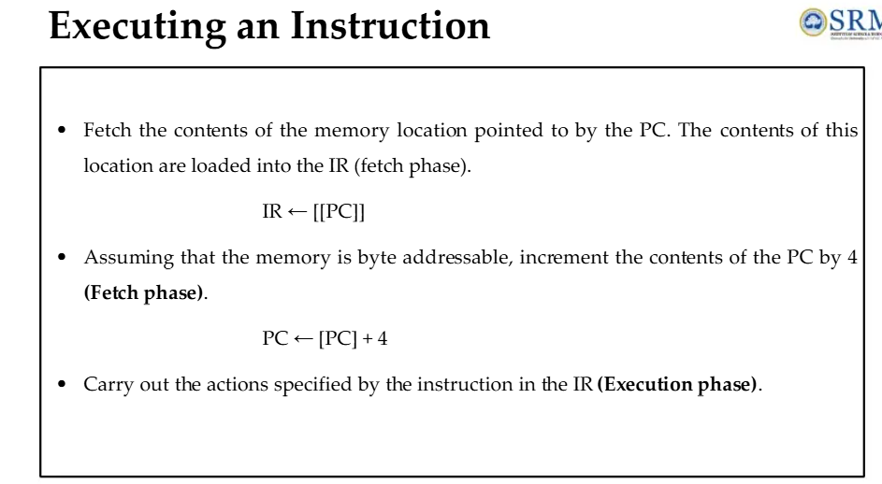

Slide 15
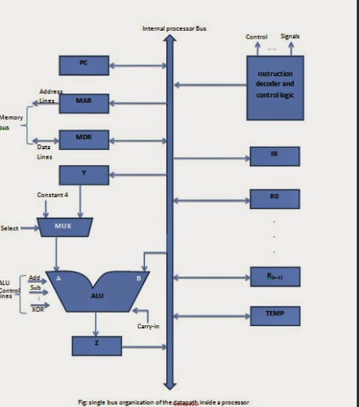
SINGLE BUS ORGANISATION

Slide 16
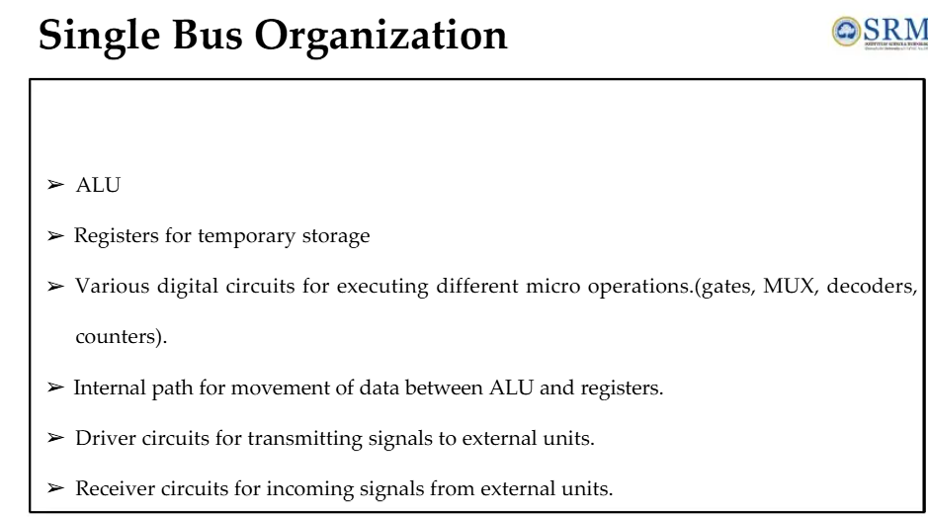

Slide 17
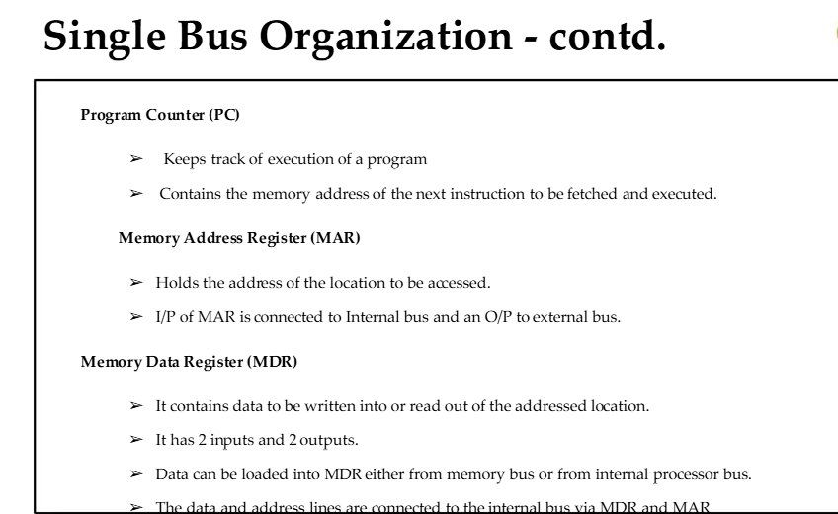

Slide 18
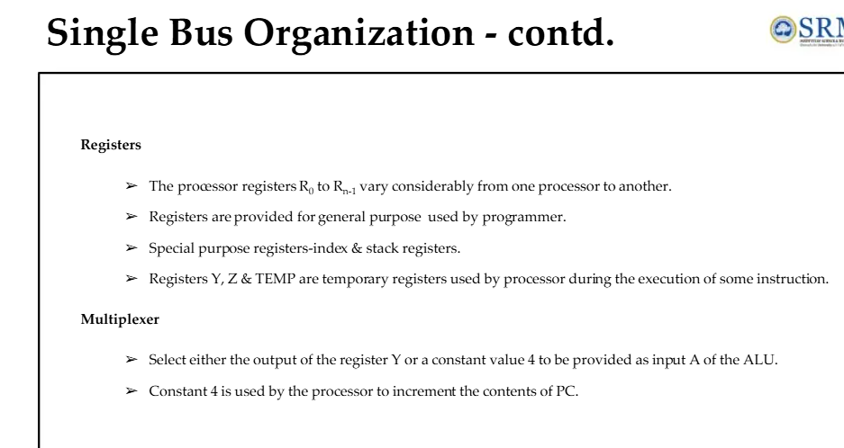

Slide 19
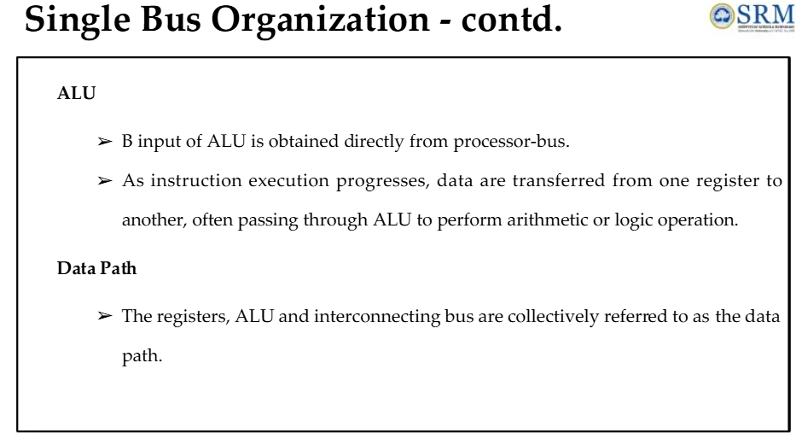

Slide 20
DATA PATH
A data path (or datapath) is a critical component of a computer's architecture, consisting of various functional units such as:
Arithmetic Logic Units (ALUs): Perform arithmetic and logical operations.
Registers: Temporary storage locations for data being processed.
Buses:Communication pathways that transfer data between components within the CPU.

Slide 21
An Instruction Can Be Executed By Performing One Or More Of The Following Operations
Transfer a word of data from one processor register to another or to the ALU
Perform an arithmetic or a logic operation and store the result in a processor register
Fetch the contents of given memory location and load them into processor register
Store a word of data from a processor register into a given memory location

Slide 22
An Instruction code is a group of bits that instructs the computer to perform a specific operation.
It is divided into two parts and the most important parts of an instruction code is its operation code or opcode. The second part is the address part which specifies the memory address.

Slide 23
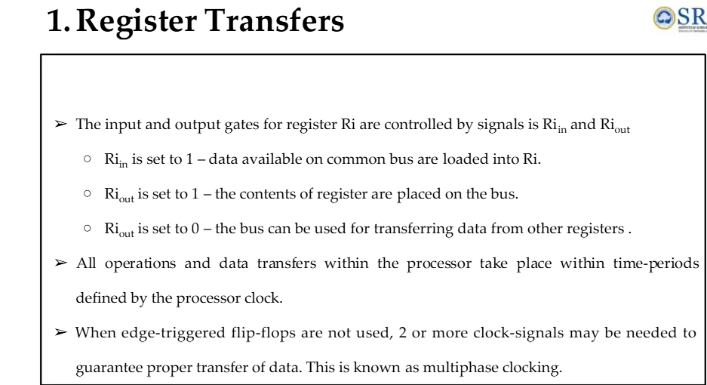

Slide 24
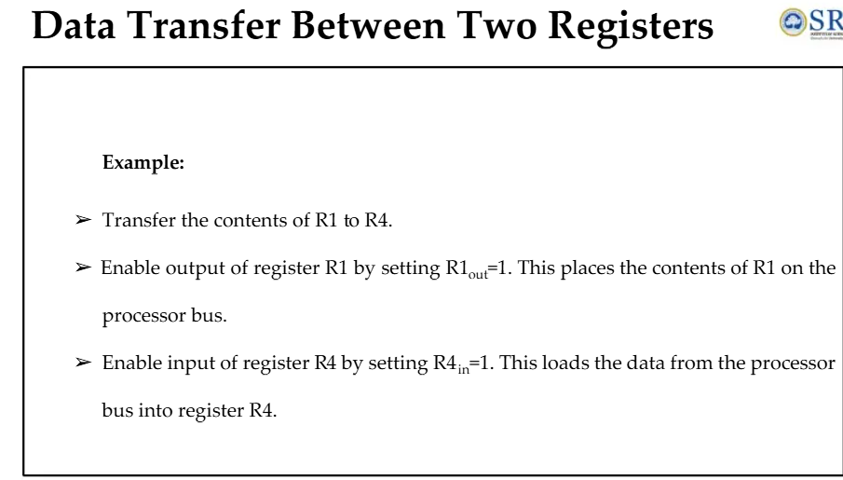

Slide 25
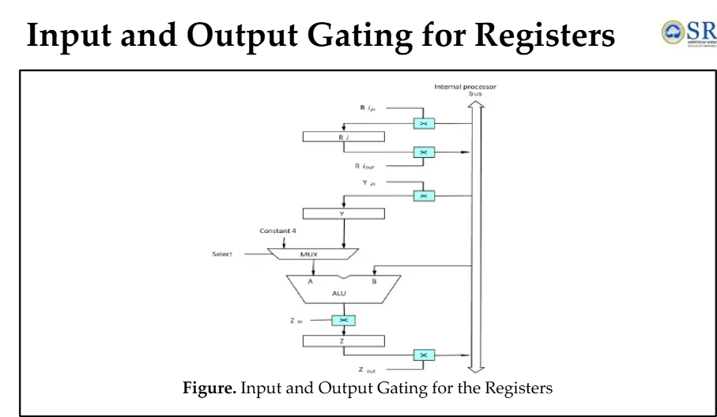

Slide 26
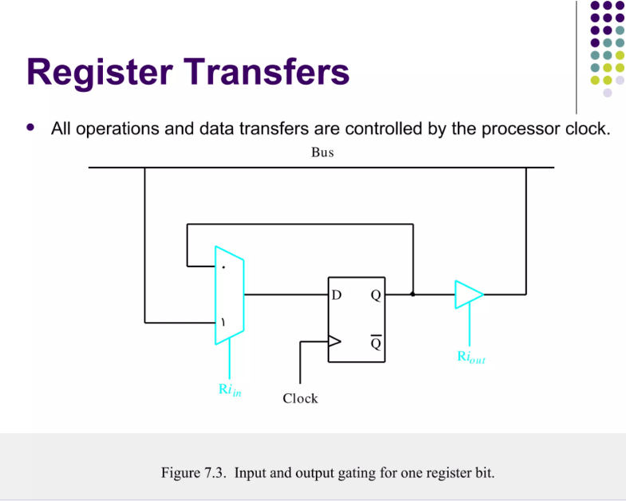

Slide 27
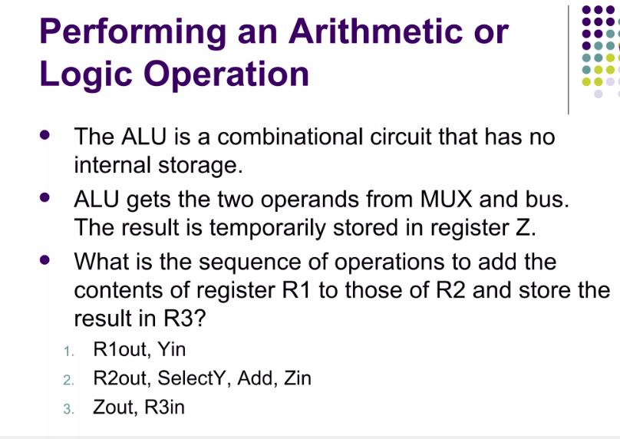

Slide 28
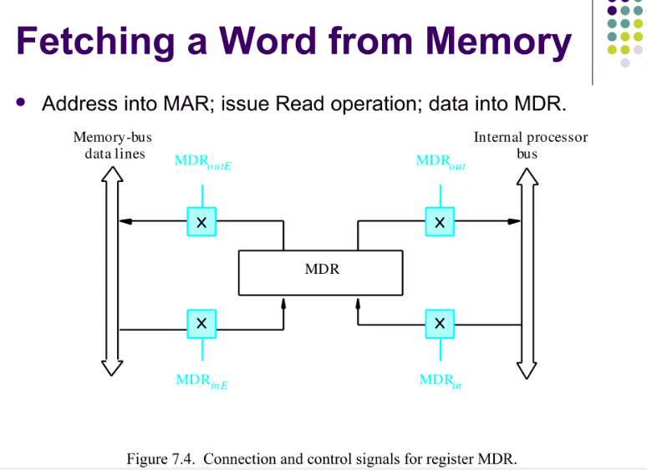

Slide 29
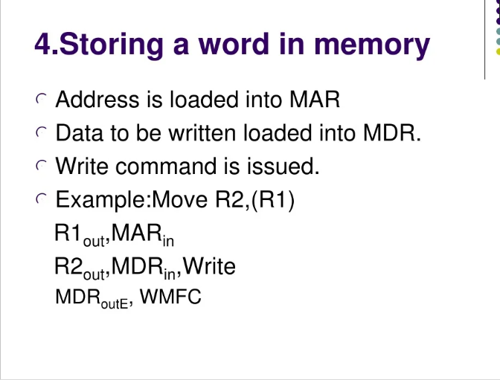
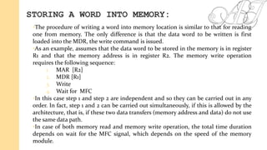

Slide 30
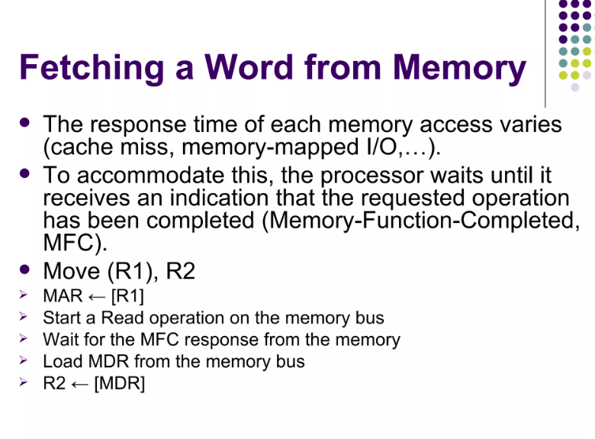

Slide 31
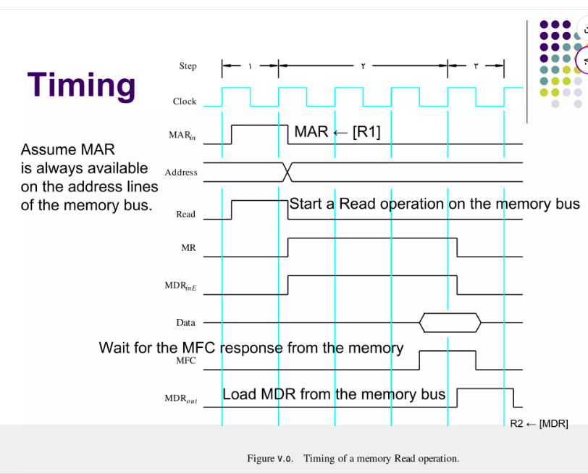

Slide 32
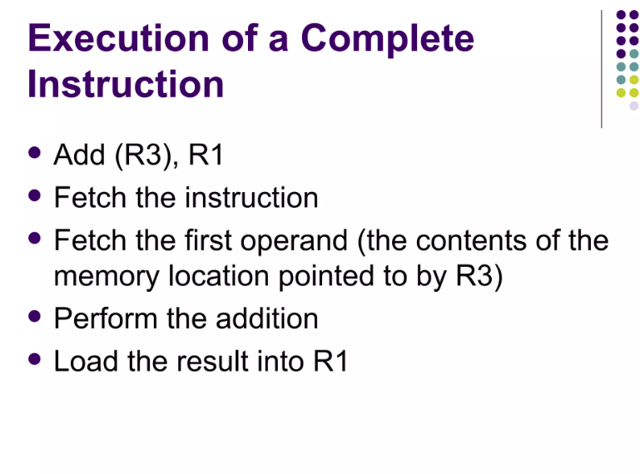

Slide 33
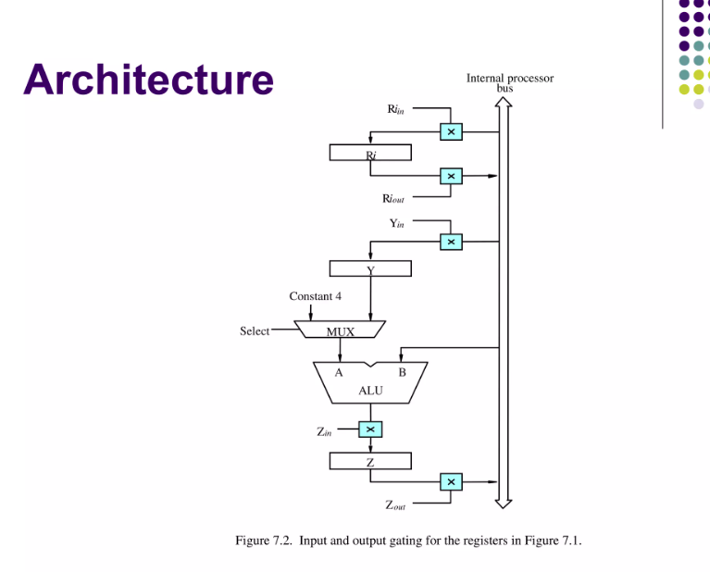

Slide 34
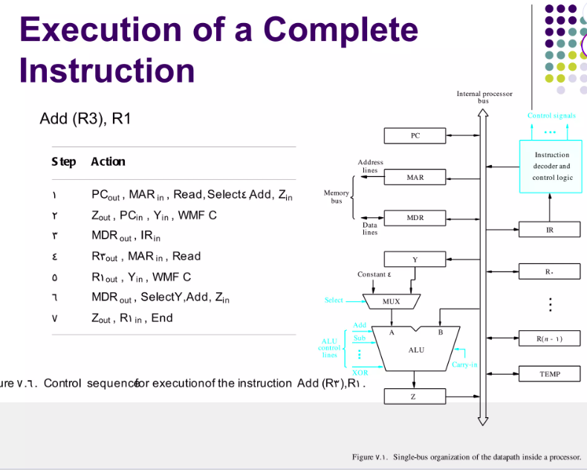

Slide 35
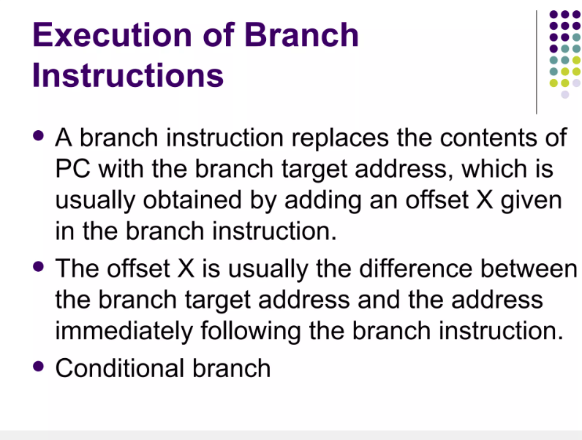

Slide 36
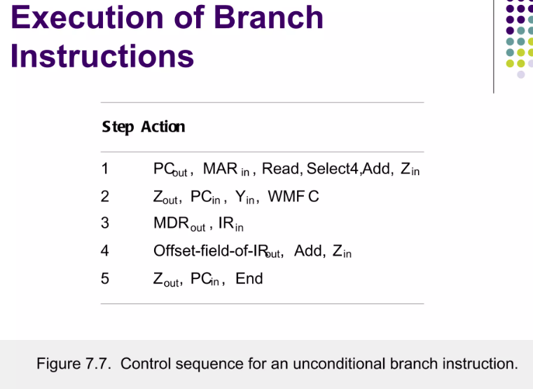

Slide 37
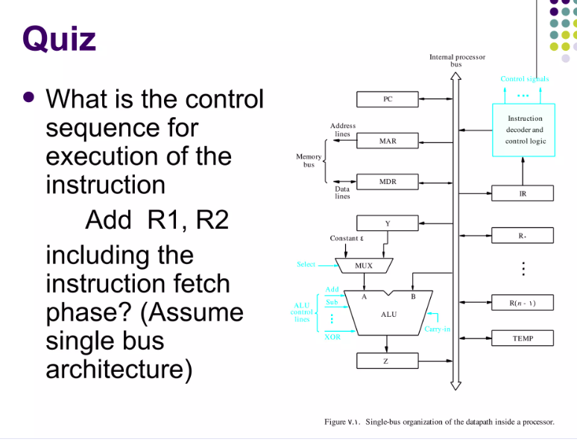

Slide 38
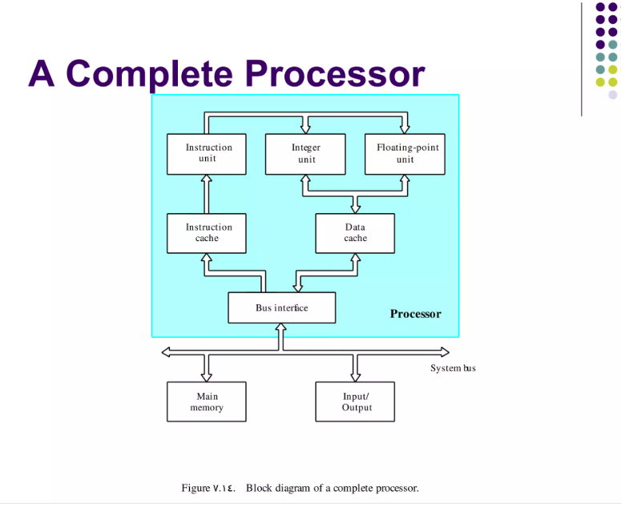

Slide 39
REGISTER TRANSFERS
In computer architecture, register transfer refers to the process of copying data between registers, which are small, fast storage locations within the CPU.
It involves the use of a register transfer language (RTL), a symbolic notation for describing these data movements and the micro-operations (like addition or shift) performed on the data.

Slide 40
A register transfer statement, such as R1 -> R2, indicates that the contents of register R1 are copied into R2. This action requires control signals to execute and data lines to facilitate the simultaneous, parallel transfer of bits during a single clock pulse, without altering the source register.

Slide 41
Key Concepts
Registers:
Small, high-speed storage units within a processor used to hold data for immediate processing.
Micro-operations:
The basic operations performed on the data stored in registers, such as data transfer, addition, subtraction, or shifting.
Register Transfer Language (RTL):
A symbolic language used to describe the micro-operations and the flow of data between registers in a digital system.
Control Functions:
Control signals that initiate or allow a register transfer to occur only when a specific condition is met (e.g., P: R1 -> R2 only happens when control signal P is 1).

Slide 42
How Register Transfer Works?
\
Source and Destination:
A register transfer involves a source register (where data is read from) and a destination register (where data is written to).
Parallel Transfer:
All bits of data from the source register are copied to the destination register simultaneously during one clock pulse.
Non-Destructive:
The transfer is non-destructive, meaning the content of the source register remains unchanged after the data is copied.
Hardware Implementation:
Register transfers require specific hardware logic circuits, including data lines connecting the registers and control lines to manage the transfer process.
Control:
A control function or signal determines when the transfer takes place, allowing for conditional execution of operations.

Slide 43
Example
R2 ← R1: This RTL statement signifies that the data stored in register R1 is copied into register R2.
P: R1 → R2: This means that the contents of R1 are transferred to R2 only when the control signal P is active (P = 1).

